Slide 1



Effectiveness of manual lymph drainage and continuous cooling following knee TEP
Jöllenbeck, T., Schönle, C.
Klinik Lindenplatz GmbH
Institute for Biomechanics
Orthopedic rehabilitation clinic
with sport medicine department,
follow-up treatment and further in-patient occupational treatment clinic
Weslarner Str. 29, 59505 Bad Sassendorf
E-mail: Thomas.Joellenbeck@klinik-lindenplatz.de
Web: www.klinik-lindenplatz.de
Department of Sport and Health
Notes:
WI33-1417 Effectiveness of manual lymph drainage and continuous cooling following knee TEP
Jöllenbeck, T., Schönle, C.
Objective: Post-operative rehabilitation following a knee TEP is frequently accompanied by pain and severe knee swelling. This compromises the patient’s ability to bend the knee, mobility and sometimes the wound healing process. As such, a primary therapeutic aim is to reduce swelling in the knee joint which has been operated on. The aim of this pilot study was to compare the effectiveness of two treatment methods - continuous cooling vs. lymph drainage.
Methodology: For this purpose, 15 patients (8F, 7M, 69.8Y) were divided up at random during in-patient rehab following a knee TEP into a cooling group (KÜ, N=8, termination of 2 VPNs) and a lymph drainage group (LY, N=7). In the KÜ group the knee joint operated on was cooled at 13-15° C for 25 minutes using a cooling cuff and cooling aggregate (company Hilotherm). The LY group received manual lymph drainage which, over the course of 25 minutes, started initially with the neck and abdomen (“to open the lymph valves”) and was then continued on the operated leg (OB) alone. These treatments were conducted in the lying position over a duration three weeks on five weekdays in each case (Mon-Fri) at 11 am. The return flow of the lymph induced from this alone was recorded by means of the check measurement on the non-operated leg (NOB). The rest of the treatment program was identical in both groups. The volume of both legs was ascertained using a perometer (company Pero-System) from the foot to the mid-thigh before and after the treatment and, additionally at 7 am and 3 pm.
Results and Conclusions: After the measurement period (20 days), the results indicate a 10.3% reduction in the volume of the operated leg in the KÜ group (722 ml from 6958 ml to 6236 ml) and a 7.7% reduction in the LY group (468 ml from 6070 ml to 5602 ml). The volume of the non-operated leg fell significantly in the KÜ group by 6.7% (430 ml from 6283 ml to 5853 ml) and in the LY group by 5.3% (295 ml from 5492 ml to 5198 ml). And in each individual treatment, a clear and significant decrease in the leg volume became apparent in all treatments, even within the 25 minutes. The volume of the operated leg fell by an average of 33.3 ml (KÜ) / 34.7 ml (LY) in each treatment. The volume of the non-operated leg also fell by 13.6 ml (KÜ) / 38.3 ml (LY) in this. During the measurement period, the volume of both legs fell considerably more so in the KÜ group (operated leg 0.54%/day; non-operated leg 0.36%/day) than in the LY group (operated leg 0.38%/day; non-operated leg 0.27%/day).
Reduction of the swelling in the operated leg was possible both by means of manual lymph drainage as well as continuous cooling. The volume of the non-operated leg also fell, which indicates that those 25 minutes in the lying position alone abate swelling in the leg. Surprisingly, the reduction in the leg volume of the non-operated leg in the lymph drainage treatment is particularly marked - sometimes even more so in the non-operated leg than the treated leg which was operated on; this could indicate that “opening the lymph valves” in the abdomen and the cervical region could actually be successful. At the same time, this study supports the clinical experience that daily rest periods with lying, cooling periods and lymph drainage are necessary measures in an effective rehabilitation program.

Slide 2
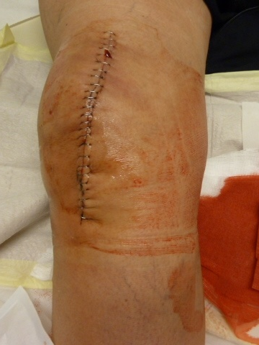
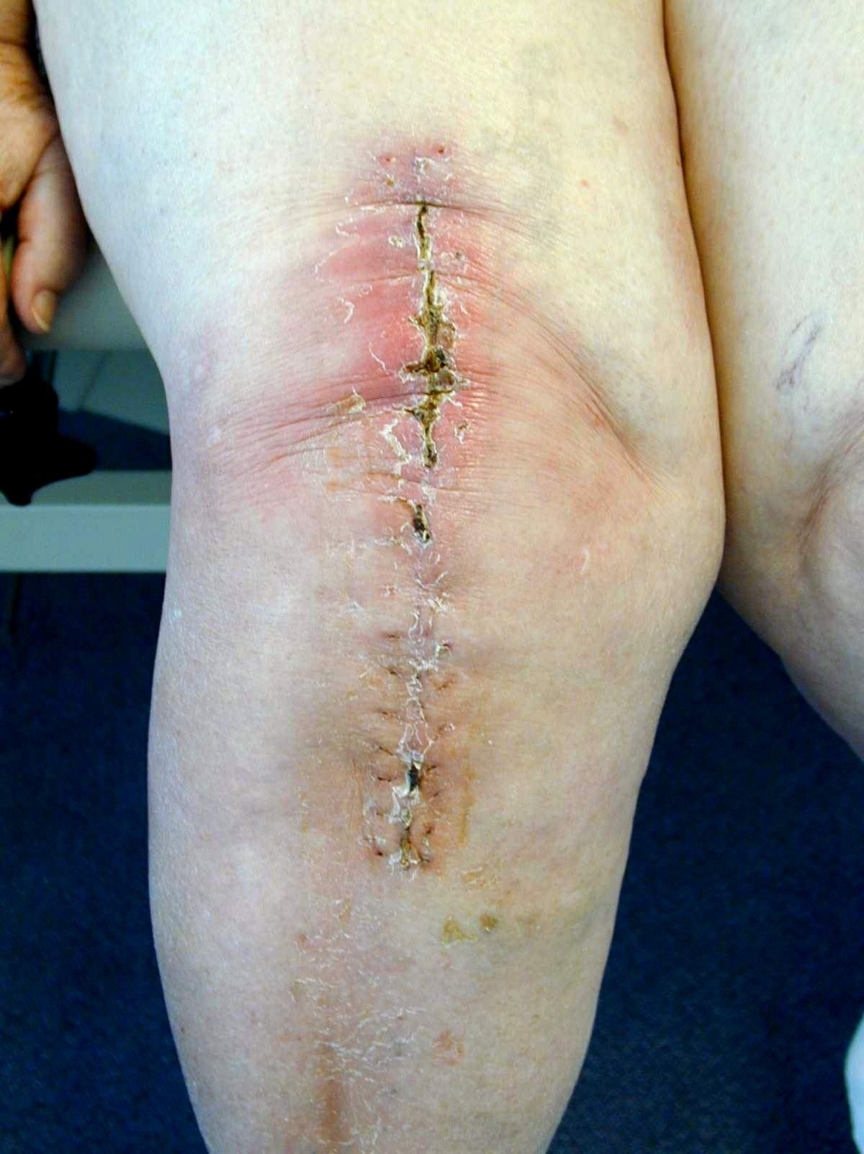
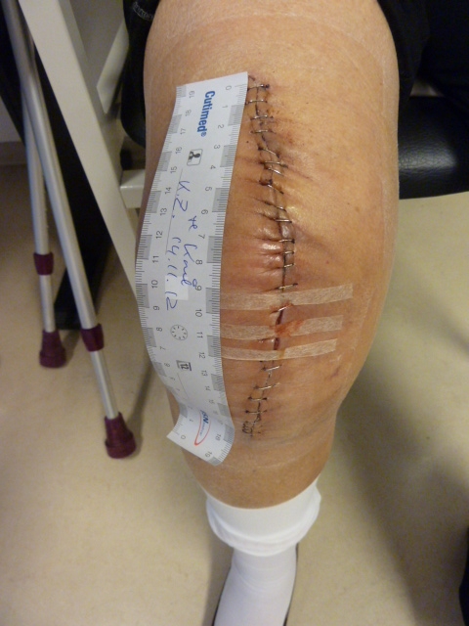
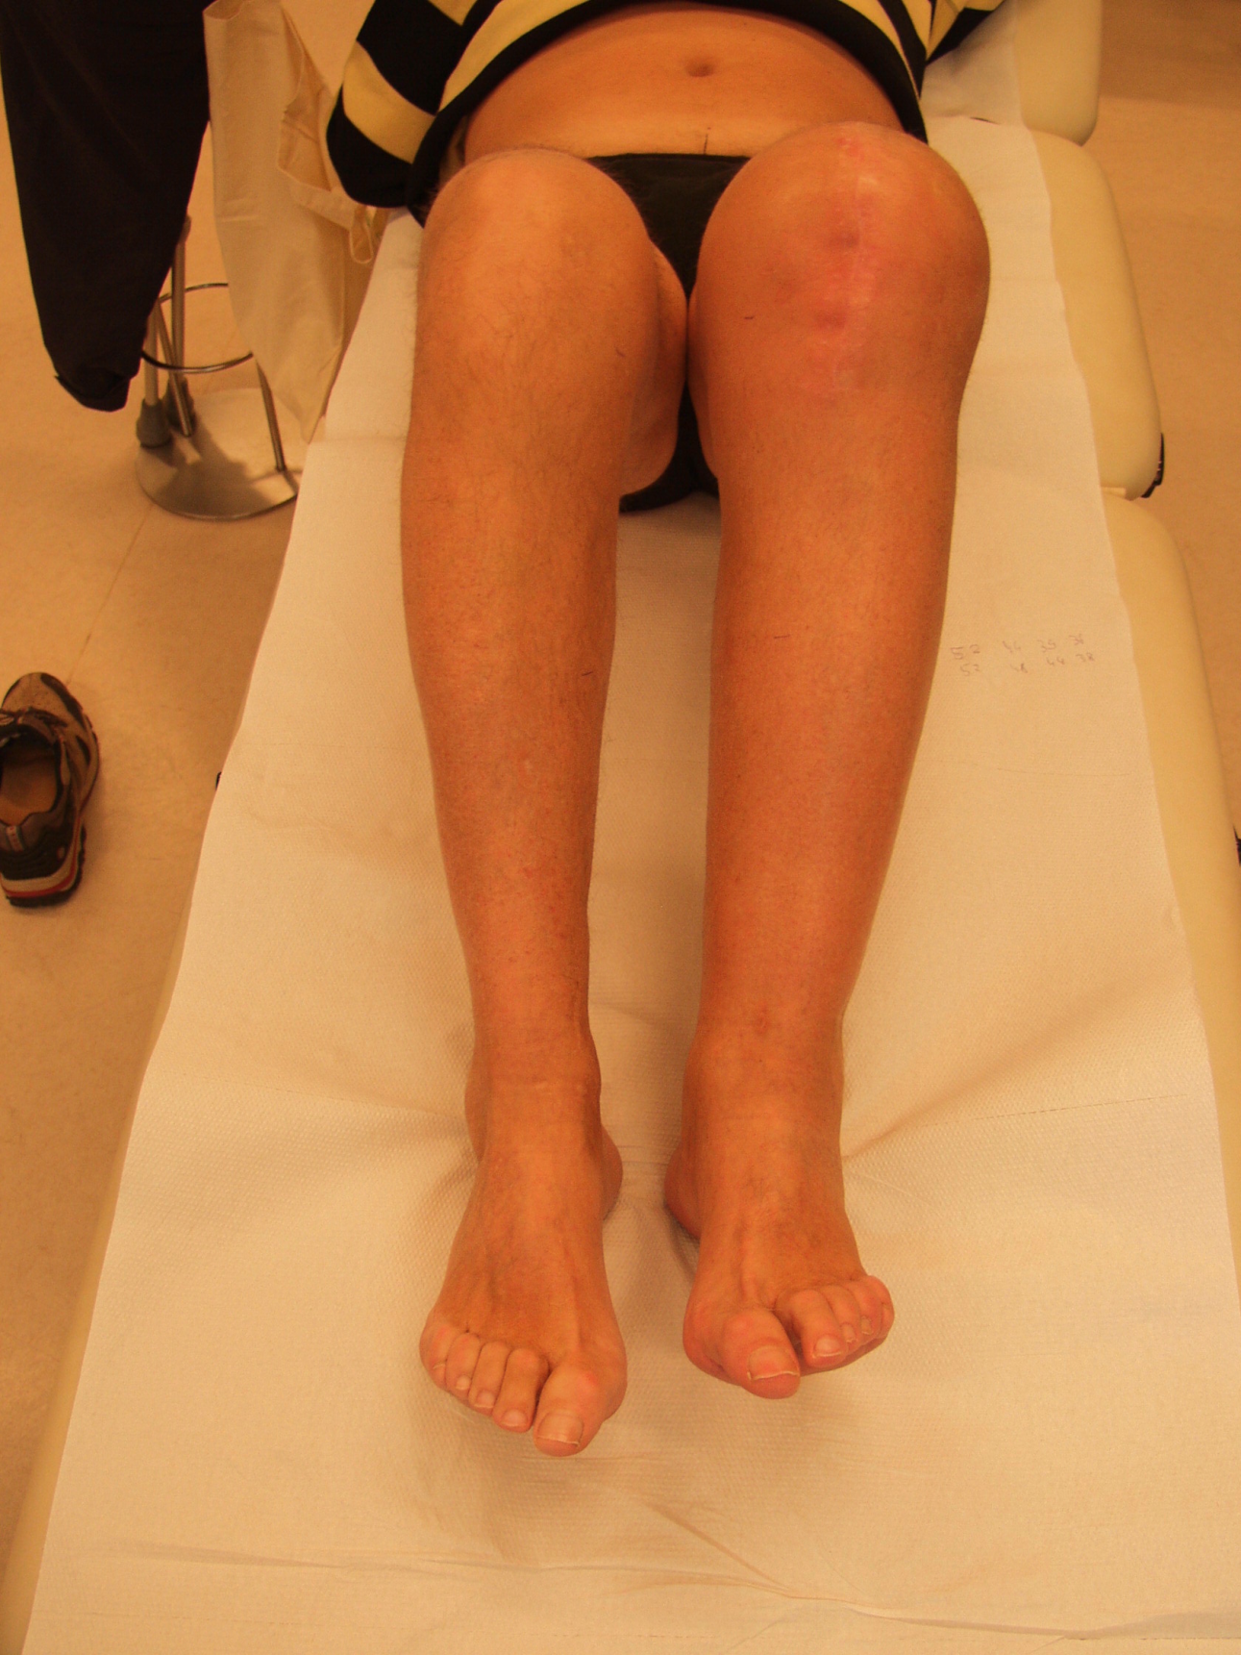
Lymph Drainage / Cooling – Why?
Typical post-OP knee swelling following knee TEP
Patient 73,
9 days post-OP
Patient 64,
13 days post-OP
Patient, 60
3 weeks post-OP
Patient, 75
4 weeks post-OP
Problem Area: Knee Swelling
Ability to bend the knee and mobility compromised
Wound healing process interrupted: - External wound dehiscence, wound edge necrosis
- Delayed internal soft tissue healing
Feeling of tightness and severe pain
Notes:
Objective: Post-operative rehabilitation following a knee TEP is frequently accompanied by pain and severe knee swelling. This compromises the patient’s ability to bend the knee, mobility and sometimes the wound healing process. As such, a primary therapeutic aim is to reduce swelling in the knee joint which has been operated on. The aim of this pilot study was to compare the effectiveness of two treatment methods - continuous cooling vs. lymph drainage.

Slide 3
Causes
Severe post-OP knee swelling following knee TEP
Rehabilitation following knee TEP
frequent in almost every second patient
  Pains
  Severe knee swelling
Causes:
Early transfer to rehabilitation post-OP
  Acute care hospital - almost complete bed rest
  ⬄ Rehab - larger walking distances required
amongst other causes
Notes:
Objective: Post-operative rehabilitation following a knee TEP is frequently accompanied by pain and severe knee swelling. This compromises the patient’s ability to bend the knee, mobility and sometimes the wound healing process. As such, a primary therapeutic aim is to reduce swelling in the knee joint which has been operated on. The aim of this pilot study was to compare the effectiveness of two treatment methods - continuous cooling vs. lymph drainage.

Slide 4
Objective
Adverse effects in rehabilitation following knee TEP
Primary therapeutic aim
Reduction in swelling of operated knee joint
Pilot study to compare effectiveness of two treatment methods
Continuous cooling
Lymph drainage
Notes:
Objective: Post-operative rehabilitation following a knee TEP is frequently accompanied by pain and severe knee swelling. This compromises the patient’s ability to bend the knee, mobility and sometimes the wound healing process. As such, a primary therapeutic aim is to reduce swelling in the knee joint which has been operated on. The aim of this pilot study was to compare the effectiveness of two treatment methods - continuous cooling vs. lymph drainage.

Slide 5
Method
Patient population / Groups
15 patients post knee TEP, randomized
(8F, 7M, 69.9Y, 1.72m, 86.7kg, BMI 29.4)
Cooling group (KÜ, N=8, termination of 2 VPNs)
  Cooling (Hilotherm), 25 min., 13-15 °C
Lymph drainage group (LY, N=7)
  Manually, 25 min., neck, abdomen (lymph valves), then just Op-leg
3 weeks, 5x/week (Mon-Fri), 11 am, lying down
Identical treatment program
Notes:
Methodology: For this purpose, 15 patients (8F, 7M, 69.8Y) were divided up at random during in-patient rehab following a knee TEP into a cooling group (KÜ, N=8, termination of 2 VPNs) and a lymph drainage group (LY, N=7). In the KÜ group the knee joint operated on was cooled at 13-15° C for 25 minutes using a cooling cuff and cooling aggregate (company Hilotherm). The LY group received manual lymph drainage which, over the course of 25 minutes, started initially with the neck and abdomen (“to open the lymph valves”) and was then continued on the operated leg (OB) alone. These treatments were conducted in the lying position over a duration three weeks on five weekdays in each case (Mon-Fri) at 11 am. The return flow of the lymph induced from this alone was recorded by means of the check measurement on the non-operated leg (NOB). The rest of the treatment program was identical in both groups. The volume of both legs was ascertained using a perometer (company Pero-System) from the foot to the mid-thigh before and after the treatment and, additionally at 7 am and 3 pm.

Slide 6
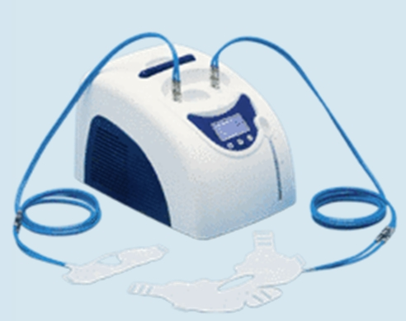
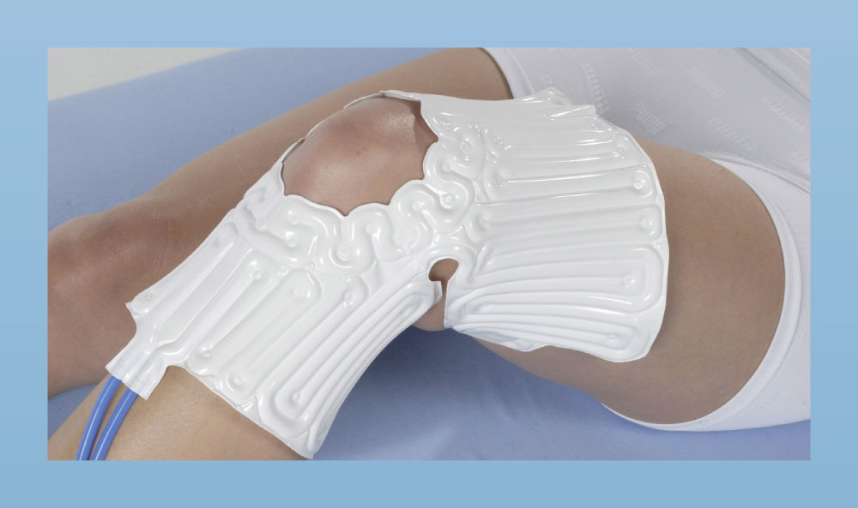
Method
Cooling Hilotherm Clinic
Continuous cooling
Hilotherm Clinic
constant temperature adjustable, here: 13-15°C
Source: www.hilotherapie.com
Notes:
Methodology: For this purpose, 15 patients (8F, 7M, 69.8Y) were divided up at random during in-patient rehab following a knee TEP into a cooling group (KÜ, N=8, termination of 2 VPNs) and a lymph drainage group (LY, N=7). In the KÜ group the knee joint operated on was cooled at 13-15° C for 25 minutes using a cooling cuff and cooling aggregate (company Hilotherm). The LY group received manual lymph drainage which, over the course of 25 minutes, started initially with the neck and abdomen (“to open the lymph valves”) and was then continued on the operated leg (OB) alone. These treatments were conducted in the lying position over a duration three weeks on five weekdays in each case (Mon-Fri) at 11 am. The return flow of the lymph induced from this alone was recorded by means of the check measurement on the non-operated leg (NOB). The rest of the treatment program was identical in both groups. The volume of both legs was ascertained using a perometer (company Pero-System) from the foot to the mid-thigh before and after the treatment and, additionally at 7 am and 3 pm.

Slide 7
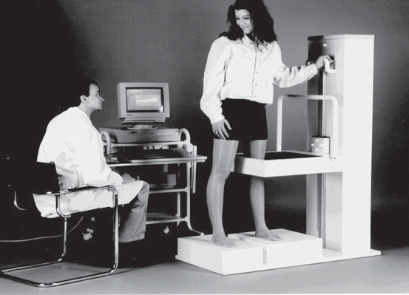
Method
Leg volume measurement
Leg volume
Perometer (Pero-System)
accuracy: <1%, (Jöllenbeck & Schönle, 2002)
Measurement: Foot to mid-thigh
Times (Mon-Fri)
  7 am
  11 am, pre & post
  3 pm
Source: www.pero-system.de
Notes:
Methodology: For this purpose, 15 patients (8F, 7M, 69.8Y) were divided up at random during in-patient rehab following a knee TEP into a cooling group (KÜ, N=8, termination of 2 VPNs) and a lymph drainage group (LY, N=7). In the KÜ group the knee joint operated on was cooled at 13-15° C for 25 minutes using a cooling cuff and cooling aggregate (company Hilotherm). The LY group received manual lymph drainage which, over the course of 25 minutes, started initially with the neck and abdomen (“to open the lymph valves”) and was then continued on the operated leg (OB) alone. These treatments were conducted in the lying position over a duration three weeks on five weekdays in each case (Mon-Fri) at 11 am. The return flow of the lymph induced from this alone was recorded by means of the check measurement on the non-operated leg (NOB). The rest of the treatment program was identical in both groups. The volume of both legs was ascertained using a perometer (company Pero-System) from the foot to the mid-thigh before and after the treatment and, additionally at 7 am and 3 pm.

Slide 8
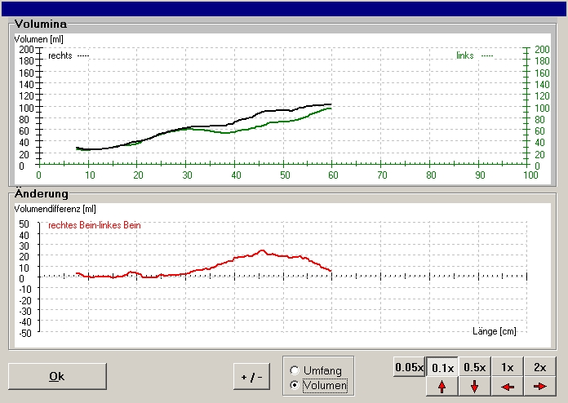
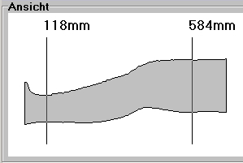
Method
Measurement leg/knee volume
Leg volume
Knee

Slide 9
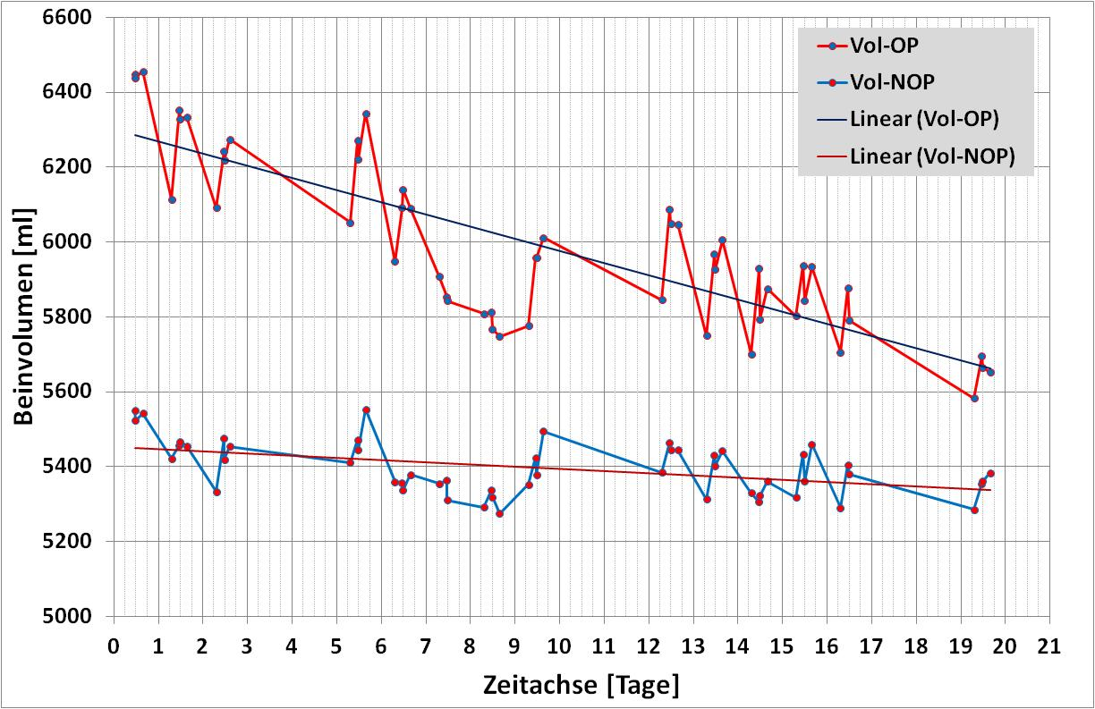
Results
Example: Leg volume over measurement period
Notes:
Results: After the measurement period (20 days), the results indicate a 10.3% reduction in the volume of the operated leg in the KÜ group (722 ml from 6958 ml to 6236 ml) and a 7.7% reduction in the LY group (468 ml from 6070 ml to 5602 ml). The volume of the non-operated leg fell significantly in the KÜ group by 6.7% (430 ml from 6283 ml to 5853 ml) and in the LY group by 5.3% (295 ml from 5492 ml to 5198 ml). And in each individual treatment, a clear and significant decrease in the leg volume became apparent in all treatments, even within the 25 minutes. The volume of the operated leg fell by an average of 33.3 ml (KÜ) / 34.7 ml (LY) in each treatment. The volume of the non-operated leg also fell by 13.6 ml (KÜ) / 38.3 ml (LY) in this. During the measurement period, the volume of both legs fell considerably more so in the KÜ group (operated leg 0.54%/day; non-operated leg 0.36%/day) than in the LY group (operated leg 0.38%/day; non-operated leg 0.27%/day).

Slide 10
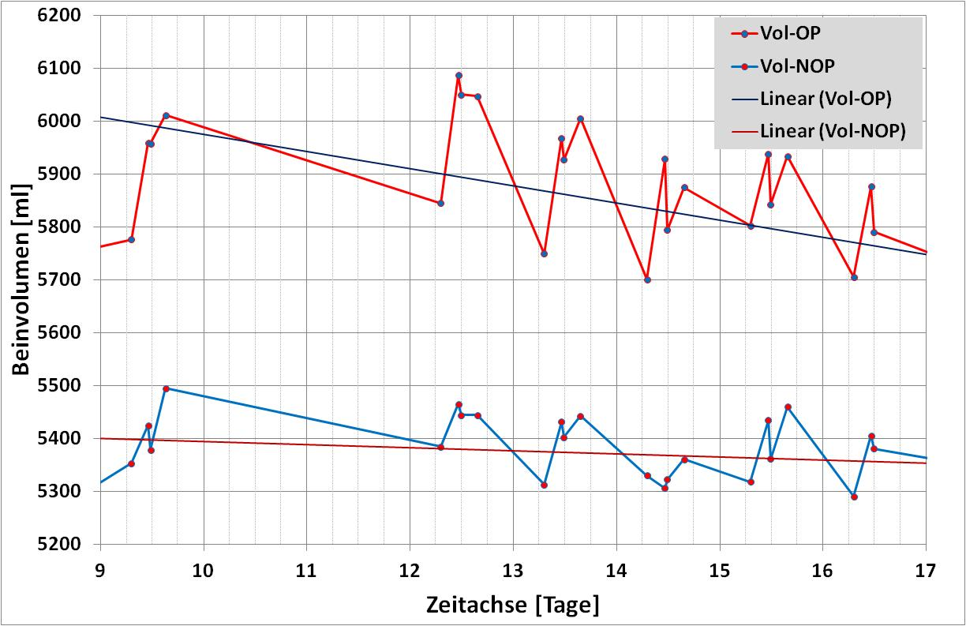
Results
Example: Section: leg volume over 1 week
Treatment
7am/11am/3pm
Weekend
Night
Fri
Sat
Sun
Mon
Tues
Wed
Thurs
Fri
Notes:
Results:

Slide 11
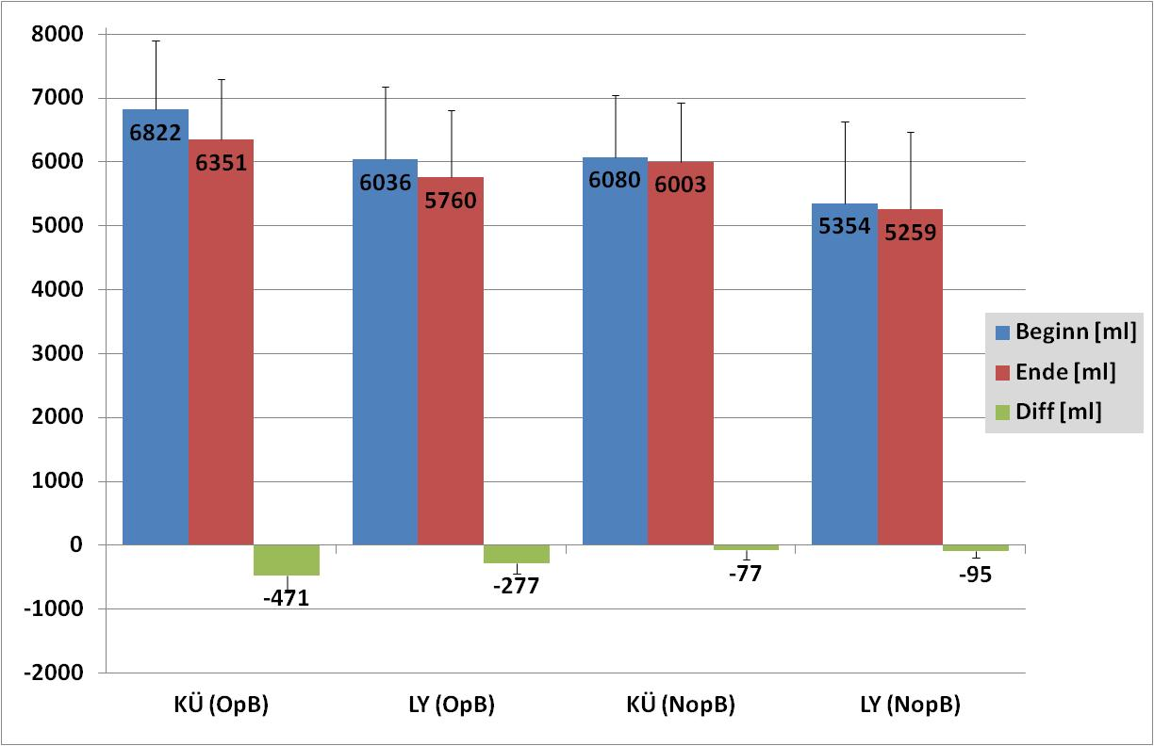
Results
Overall change in leg volume (absolute)
* p=.002
*** p=.000
sT - p=.066
p=.402
** p=.004
** p=.001
p=.248
p=.063
Notes:
Change in leg volume results:
OP side: Cooling vs lymph: only sign. trend: greater reduction in leg volume over the entire time in cooling compared with lymph
NOP: Leg volume almost unchanged over entire period
OP vs. NOP: significant reduction in OP leg volume compared with NOP leg volume both in the case of cooling and lymph

Slide 12
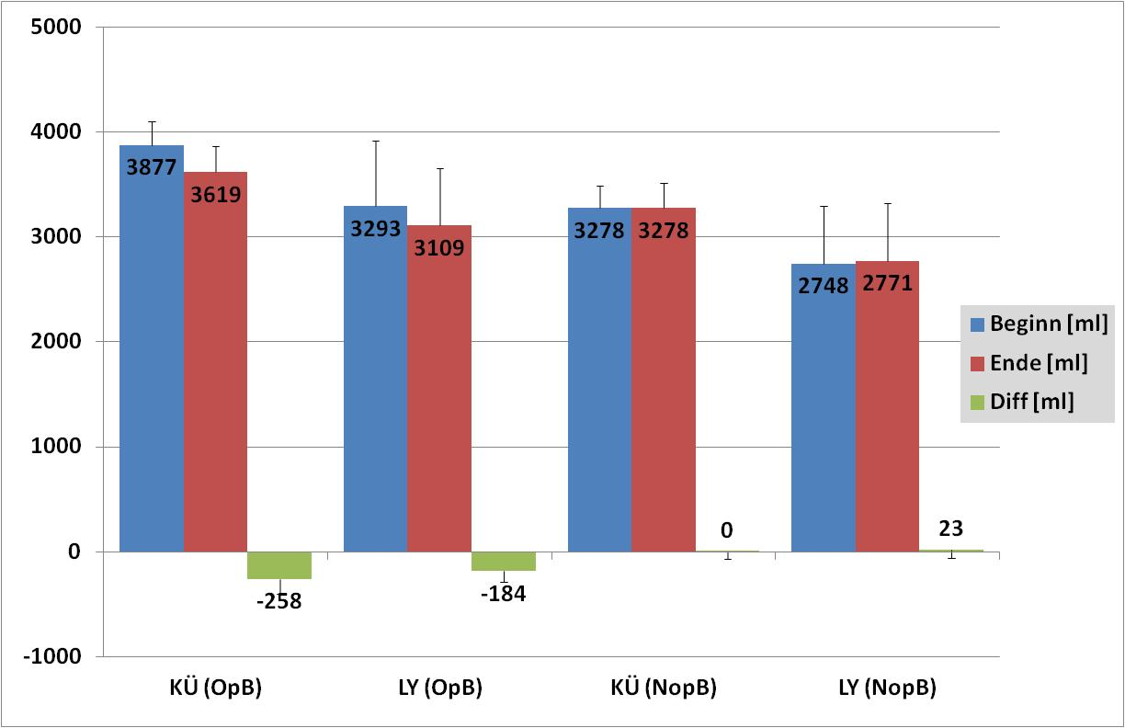
Results
Overall change in knee volume (absolute)
** p=.003
** p=.002
p=.163
p=.610
** p=.003
** p=.003
p=.990
p=.528
Notes:
Change in knee volume results:
OP side: Cooling vs lymph: no difference in change of knee volume over entire period
NOP: Knee volume unchanged over entire period
OP vs. NOP: significant reduction in OP leg volume compared with NOP leg volume both in the case of cooling and lymph

Slide 13
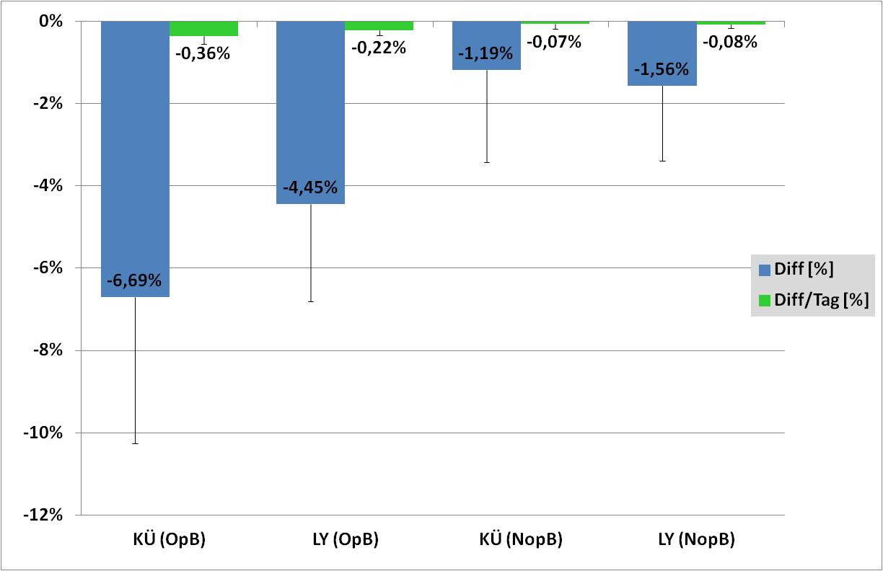
Results
Change in leg volume (percentage-based)
sT - p=.094
p=.804
sT - p=.071
p=.873
Notes:
Leg volume results:
OP side: Cooling vs lymph: only sign. trend (cooling more so than lymph) in percentage-based change in leg volume over entire period
NOP: all remained unchanged throughout entire duration

Slide 14
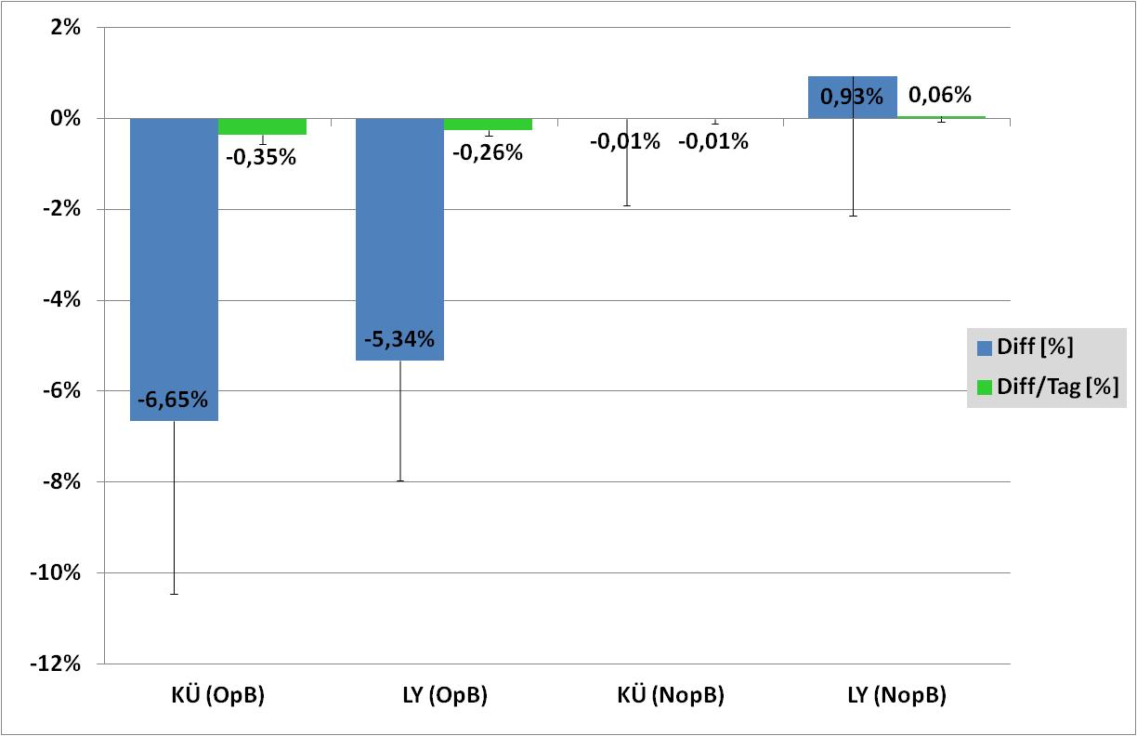
Results
Change in knee volume (percentage-based)
p=.251
p=.160
Notes:
Results: Results:
OP side: Cooling vs lymph: no difference in percentage-based change of knee volume over entire period
NOP: all remained unchanged throughout entire duration

Slide 15
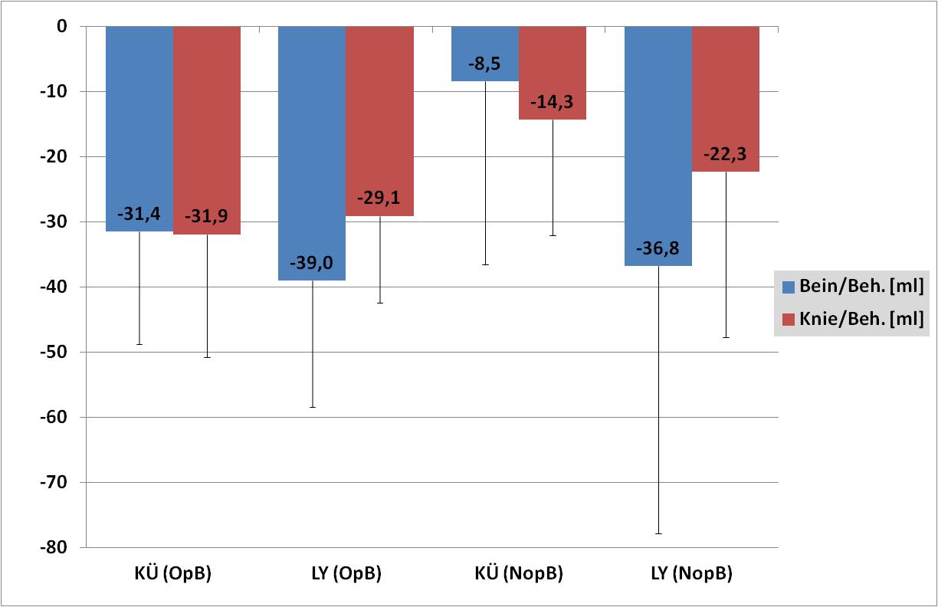
Results
Leg volume pre-post treatment
* p=.041
* p=.045
Notes:
Results:
Cooling: sign. greater leg volume reduction in OP than NOP
Lymph: sign. greater reduction in leg volume than in knee volume
Other data: no sign. differences

Slide 16
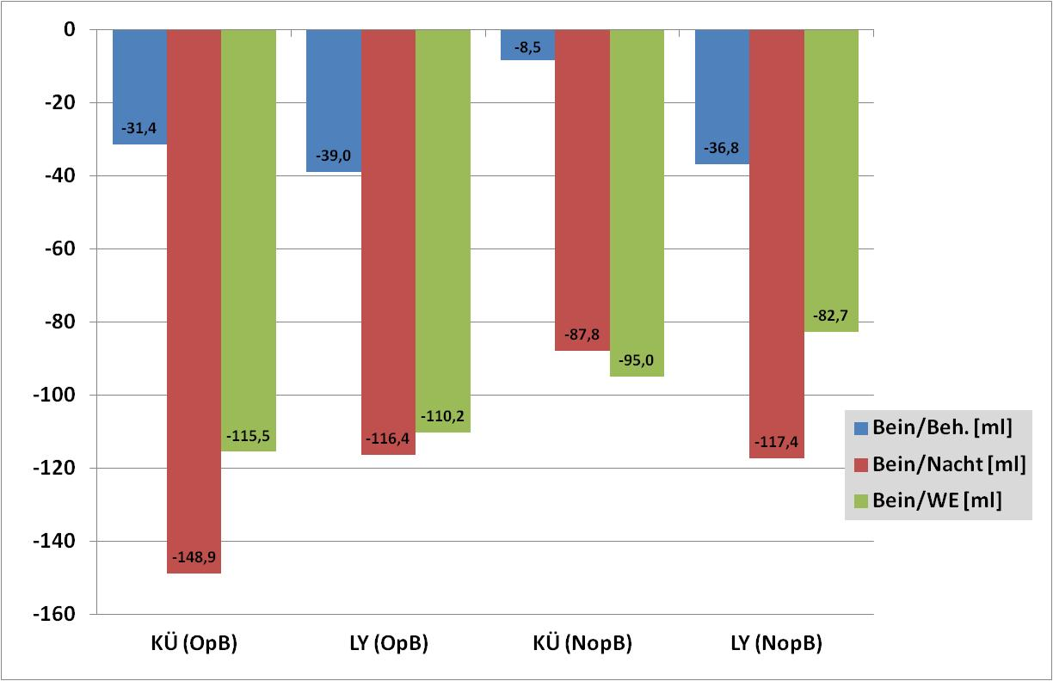
Results
Leg volume: Treatment vs. night rest & weekend
*/*** p<.016
**/** p<.006
*/* p<.030
**/* p<.013
Notes:
Results:
Cooling & lymph: sign. greater reduction in leg volume both in OP and NOP leg as a result of night rest or weekend rest

Slide 17
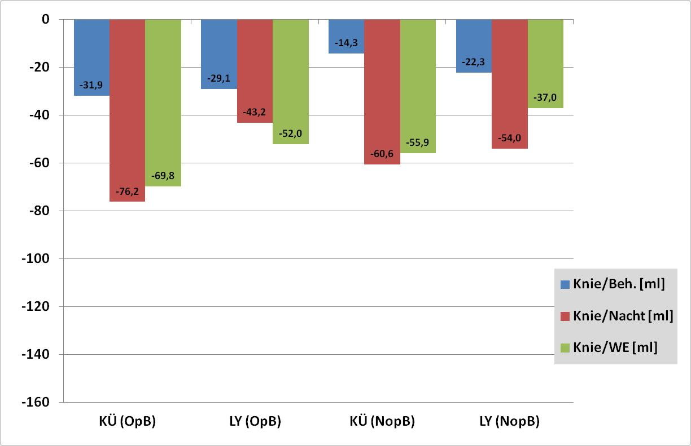
Results
Knee volume: Treatment vs. night rest & weekend
sT/* p<.098
sT/sT p<.079
**/* p<.014
*/* p<.048
Notes:
Knee volume results:
OP: Cooling & lymph: sign. only cooling weekend, otherwise only sign. trend greater reduction in leg volume as a result of night rest or weekend rest
NOP: Cooling & lymph: sign. greater reduction in leg volume as a result of night rest or weekend rest

Slide 18
Discussion
Entire treatment period
Reduction of the leg and knee volume on the operated side
No reduction in leg and knee volume on non-operated and non-treated side
Cooling on operated leg
not more effective than lymph drainage

Slide 19
Discussion
Treatment effectiveness – ½ hour of therapy
Reduction of leg and knee volume on
OP side with both continuous cooling
and lymph drainage
Cooling: Reduction in leg volume same as reduction in knee volume
Lymph drainage: additional reduction in leg volume
Cooling on operated leg
not more effective than lymph drainage
Reduction leg/knee volume on NOP side too
Treatment not very effective

Slide 20
Discussion
Therapy effectiveness => OP and NOP side
Therapy whereby a patient lies on an examination table for 30 minutes has a volume-reducing effect
When a patient lies in bed at night,
far greater volume reduction is regularly seen, amounting to 2–10 times the therapeutic effect
Even over the weekend, where no therapy is carried out, a clear volume reduction becomes apparent

Slide 21
Conclusions
Part 1
Thus far, a low number of patient cases has prevented any statement from being made as to which of the two treatments is more effective- if at all
Lying down alone seems to have a considerable effect on the reduction of volume
For that reason, continuous bed rest would be optimum for reducing swelling
However, this goes against active mobilization of the patient
Notes:
Conclusion: Reduction of the swelling in the operated leg was possible both by means of manual lymph drainage as well as continuous cooling. The volume of the non-operated leg also fell, which indicates that those 25 minutes in the lying position alone abate swelling in the leg. Surprisingly, the reduction in the leg volume of the non-operated leg in the lymph drainage treatment is particularly marked - sometimes even more so in the non-operated leg than the treated leg which was operated on; this could indicate that “opening the lymph valves” in the abdomen and the cervical region could actually be successful. At the same time, this study supports the clinical experience that daily rest periods with lying, cooling periods and lymph drainage are necessary measures in an effective rehabilitation program.

Slide 22
Conclusions
Part 2
As such, a balance between
  activation
  strength training, endurance sessions, coordination training,
  passive and active knee mobilization
  and
  regeneration
  elevation and cooling, lymph drainage
should be ensured in the rehabilitation process following a knee operation.
Notes:
Conclusion: Reduction of the swelling in the operated leg was possible both by means of manual lymph drainage as well as continuous cooling. The volume of the non-operated leg also fell, which indicates that those 25 minutes in the lying position alone abate swelling in the leg. Surprisingly, the reduction in the leg volume of the non-operated leg in the lymph drainage treatment is particularly marked - sometimes even more so in the non-operated leg than the treated leg which was operated on; this could indicate that “opening the lymph valves” in the abdomen and the cervical region could actually be successful. At the same time, this study supports the clinical experience that daily rest periods with lying, cooling periods and lymph drainage are necessary measures in an effective rehabilitation program.

Slide 23
Thank you for your attention
Effectiveness of manual lymph drainage
and continuous cooling following knee TEP
Jöllenbeck, T., Schönle, C.
Klinik Lindenplatz GmbH
Institute for Biomechanics
Orthopedic rehabilitation clinic
with sport medicine department,
follow-up treatment and further in-patient occupational treatment clinic
Weslarner Str. 29, 59505 Bad Sassendorf
E-mail: Thomas.Joellenbeck@klinik-lindenplatz.de
Web: www.klinik-lindenplatz.de
Department of Sport and Health
Notes:
WI33-1417 Effectiveness of manual lymph drainage and continuous cooling following knee TEP
Jöllenbeck, T., Schönle, C.
Objective: Post-operative rehabilitation following a knee TEP is frequently accompanied by pain and severe knee swelling. This compromises the patient’s ability to bend the knee, mobility and sometimes the wound healing process. As such, a primary therapeutic aim is to reduce swelling in the knee joint which has been operated on. The aim of this pilot study was to compare the effectiveness of two treatment methods - continuous cooling vs. lymph drainage.
Methodology: For this purpose, 15 patients (8F, 7M, 69.8Y) were divided up at random during in-patient rehab following a knee TEP into a cooling group (KÜ, N=8, termination of 2 VPNs) and a lymph drainage group (LY, N=7). In the KÜ group the knee joint operated on was cooled at 13-15° C for 25 minutes using a cooling cuff and cooling aggregate (company Hilotherm). The LY group received manual lymph drainage which, over the course of 25 minutes, started initially with the neck and abdomen (“to open the lymph valves”) and was then continued on the operated leg (OB) alone. These treatments were conducted in the lying position over a duration three weeks on five weekdays in each case (Mon-Fri) at 11 am. The return flow of the lymph induced from this alone was recorded by means of the check measurement on the non-operated leg (NOB). The rest of the treatment program was identical in both groups. The volume of both legs was ascertained using a perometer (company Pero-System) from the foot to the mid-thigh before and after the treatment and, additionally at 7 am and 3 pm.
Results and Conclusions: After the measurement period (20 days), the results indicate a 10.3% reduction in the volume of the operated leg in the KÜ group (722 ml from 6958 ml to 6236 ml) and a 7.7% reduction in the LY group (468 ml from 6070 ml to 5602 ml). The volume of the non-operated leg fell significantly in the KÜ group by 6.7% (430 ml from 6283 ml to 5853 ml) and in the LY group by 5.3% (295 ml from 5492 ml to 5198 ml). And in each individual treatment, a clear and significant decrease in the leg volume became apparent in all treatments, even within the 25 minutes. The volume of the operated leg fell by an average of 33.3 ml (KÜ) / 34.7 ml (LY) in each treatment. The volume of the non-operated leg also fell by 13.6 ml (KÜ) / 38.3 ml (LY) in this. During the measurement period, the volume of both legs fell considerably more so in the KÜ group (operated leg 0.54%/day; non-operated leg 0.36%/day) than in the LY group (operated leg 0.38%/day; non-operated leg 0.27%/day).
Reduction of the swelling in the operated leg was possible both by means of manual lymph drainage as well as continuous cooling. The volume of the non-operated leg also fell, which indicates that those 25 minutes in the lying position alone abate swelling in the leg. Surprisingly, the reduction in the leg volume of the non-operated leg in the lymph drainage treatment is particularly marked - sometimes even more so in the non-operated leg than the treated leg which was operated on; this could indicate that “opening the lymph valves” in the abdomen and the cervical region could actually be successful. At the same time, this study supports the clinical experience that daily rest periods with lying, cooling periods and lymph drainage are necessary measures in an effective rehabilitation program.

